Slide 1
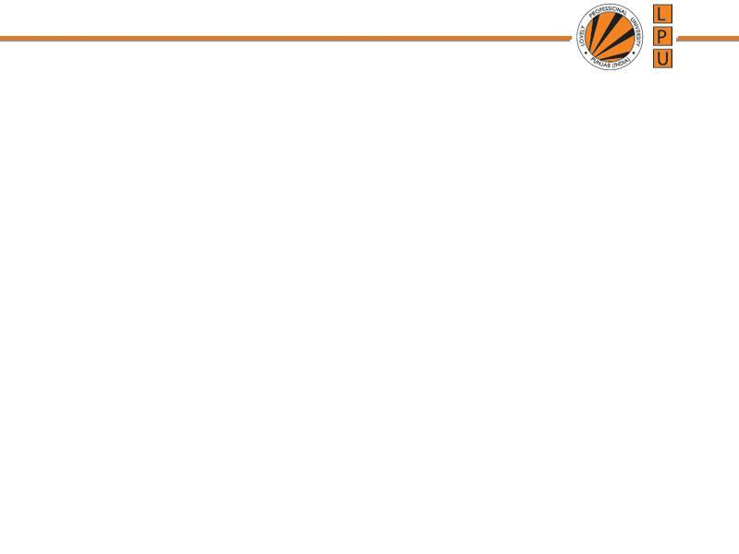
Introduction to Data Structures
Unit 1: Asymptotic analysis (Big-O notation)

Slide 2
Algorithm: Outline, the essence of a computational procedure, step-by-step instructions
Program: an implementation of an algorithm in some programming language
Algorithmic Problem
Specification of input
Specification of output as a function of input
?

Slide 3
( Infinitely many correct algorithms for the same algorithmic problem )
Correctness of the algorithm is not the only thing
Need to compare algorithm
Find out efficient algorithm
Analyse the algorithm (Complexity Analysis)
What is an Efficient Algorithm?
Taking less Running time (Analysis of Time complexity)
Using less Space (Analysis of Space complexity)

Slide 4
Time Space Trade off
A situation where the memory use can be reduced at the cost of slower program execution (e.g. using linear search for searching records on multiple criterion)
Or
the computation time can be reduced at the cost of increased memory use (e.g. using multiple indexes for searching)
As the relative costs of CPU cycles, RAM space, and hard drive space change—the appropriate choices for time space tradeoff have changed radically.

Slide 5
Time Complexity
The running time of an algorithm is the total number of primitive operations executed
The exact number of steps will depend on exactly what machine or language is being used
To avoid that problem, the Asymptotic Notation is used.
Algorithm complexity is rough estimation of the number of steps performed by given computation depending on the size of the input data, measured through Asymptotic Notation
Usually, the time required by an algorithm falls under three types −
Best Case − Minimum time required for program execution.
Average Case − Average time required for program execution.
Worst Case − Maximum time required for program execution.

Slide 6
Rate of Growth
log₂n < √n<n < nlog₂n < n² < n³ < 2^{n}
Constant | Ο(1)
Logarithmic | Ο(log n)
Linear | Ο(n)
Log Linear | Ο(n log n)
Quadratic | Ο(n²)
Cubic | Ο(n³)
Polynomial | n^{Ο(1)}
Exponential | 2^{Ο(n)}

Slide 7
Asymptotic Notation
Asymptotic notation of an algorithm is a mathematical representation of its complexity
An asymptote of a curve is a line such that the distance between the curve and the line approaches zero as one or both of the x or y coordinates tends to infinity.
It is a method of describing limiting behaviour.
e.g. If f(n) = n² + 3n, then as n becomes very large, the term 3n becomes insignificant compared to n².
The function f(n) is said to be "asymptotically equivalent to n², as n → ∞".

Slide 8
Commonly used asymptotic notations to calculate the running time complexity of an algorithm are
Ο Notation (Big Oh Notation)
Ω Notation (Omega Notation)
θ Notation (Theta Notation)

Slide 9
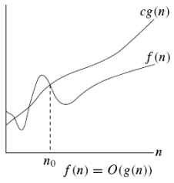

Big Oh Notation - Asymptotic upper bound
It measures the worst case time complexity or the longest amount of time an algorithm can possibly take to complete.

Slide 10
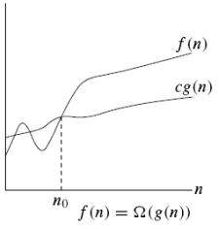

Ω Notation - Asymptotic lower bound
It measures the best case time complexity or the best amount of time an algorithm can possibly take to complete
the best case performance of an algorithm is generally not useful, the Omega notation is the least used notation among all three.

Slide 11
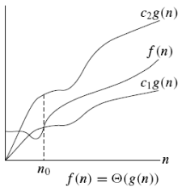

Θ Notation – bounds a functions from above and below
It measures the average case time complexity

Slide 12
Basic Rules for calculating complexity
1. Nested loops are multiplied together. 2. Sequential loops are added. 3. Only the largest term is kept, all others are dropped. 4. Constants are dropped. 5. Conditional checks are constant (i.e. 1).

Slide 13
Measuring Efficiency of an algorithm
We are more interested in finding out the Worst Case Complexity or Big O

Slide 14
Analysis of Algorithms
// Here c is a constant
for (int i = 1; i <= c; i++)
{
// some O(1) expressions
}

Slide 15
#include <iostream> int main(){ int c = 4; cin>>n; int d = c*5; }
Reviewing Complexity

Slide 16
#include <iostream> int main(){ int c = 4; → 1 cin>>n; → 1 int d = c*5; → 1 } O(1+1+1) = constant time
Reviewing Complexity

Slide 17
for(int i =0; i<n ;i++){ int c = c+n; }
Reviewing Complexity

Slide 18
for(int i =1; i<n ;i+=2){ stmt; }
Reviewing Complexity

Slide 19
for(int i =0; i<n ;i++){ for(int j = 0; j<n;j++){ int d = d*6; } }
Reviewing Complexity

Slide 20
int a = 0, b = 0; for (i = 0; i < N; i++) { a = a + rand(); } for (j = 0; j < M; j++) { b = b + rand(); }
Reviewing Complexity

Slide 21
Answer int a = 0; →1 int b = 0; → 1 for (i = 0; i < N; i++) { → n+1 a = a + rand(); → n } for (j = 0; j < M; j++) { →m+1 b = b + rand(); →m } total steps : 4+2n+2m =2(n+m) +4 ignore constant ->O(N+M)

Slide 22
int a = 0;
for (i = 0; i < N; i++) {
for (j = N; j > i; j--) {
a = a + i + j;
}
}
Reviewing Complexity

Slide 23
-- for(i=1; i<=n;i=*2){ stmt; }
Reviewing Complexity

Slide 24
i=1 1*2 Assume i>=n
i=2 2*2=2² 2^{k} >=n
i=3 2^{2*} *2=2³ 2^{k} =n
⁻⁻⁻⁻ k=o(logn)
⁻⁻⁻⁻
⁻⁻⁻⁻
2^{k}

Slide 25
-- for(i=n; i>=1;i=i/2){ stmt; }
Reviewing Complexity

Slide 26
-- p=0; for(i=1; p<=n;i++){ p = p+i; }
Reviewing Complexity

Slide 27
i=1 p=0+1 Assume p>=n
i=2 1+2 k(k+1)/2
i=3 ¹⁺²⁺³ k²>n
⁻⁻⁻⁻ k=o(sqrt(n))
⁻⁻⁻⁻
⁻⁻⁻⁻
k k(k+1)/2

Slide 28
for(int i =0; i<n ;i++){ for(int j=0;j<i;j++) stmt; } }
Reviewing Complexity

Slide 29
Suppose we had an algorithm that took in an array of strings, sorted each string, and then sorted the full array. What would the runtime be?

Slide 30
1. Sorting Each String
Suppose the array has n strings, and the average length of each string is m.
Sorting each string individually would take O(mlog⁡m) time per string.
Since there are n strings, the total time to sort all the strings is O(n⋅mlog⁡m)
2. Sorting the Full Array
After sorting each string, the array is sorted.
Each comparison between two strings will take O(m) time since we may need to compare up to m characters.
Sorting the full array of n strings will therefore take O(nlog⁡n) comparisons, with each comparison taking O(m) time.
Hence, the time to sort the entire array will be O(n⋅mlog⁡n).
Overall Runtime
Combining both steps, the total runtime of the algorithm is the sum of the two main operations: O(n⋅mlog⁡m)+O(n⋅mlog⁡n)
Since mlog⁡m and mlogn are comparable, the overall runtime is dominated by the larger of the two terms. Therefore, the runtime is: O(n⋅m(log⁡m+log⁡n))
This can be simplified to: O(n⋅mlog⁡(mn))

Slide 31
Given a number n, find the sum of the first n natural numbers.

Slide 32
